Slide 1

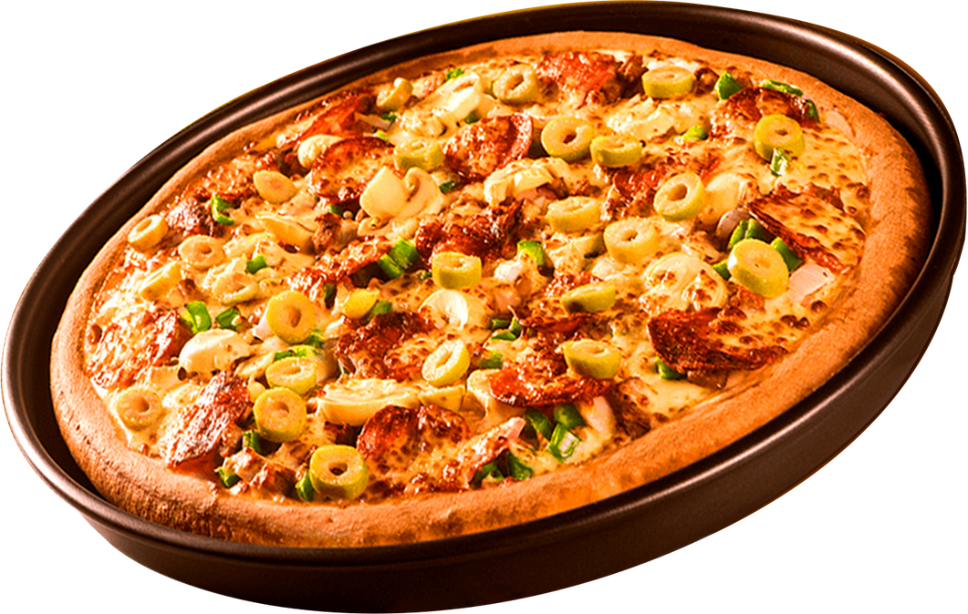

PIZZA SALES ANALYSIS USING SQL

Slide 2

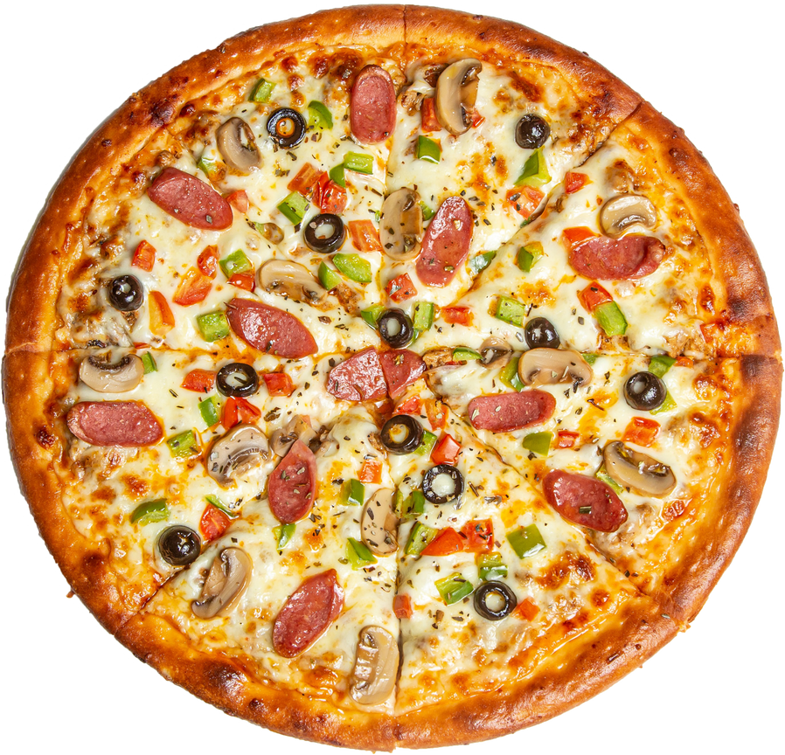
WHY THIS PROJECT?
To analyze pizza sales and revenue.
To understand customer order behavior.
To identify best-sellers & business opportunities.

Slide 3
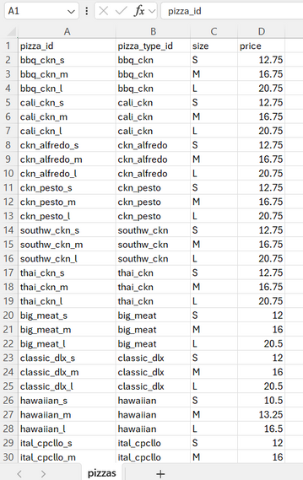
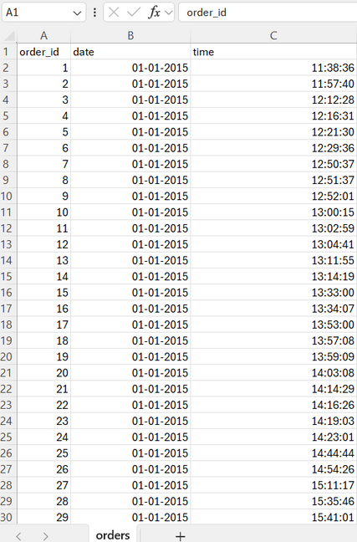
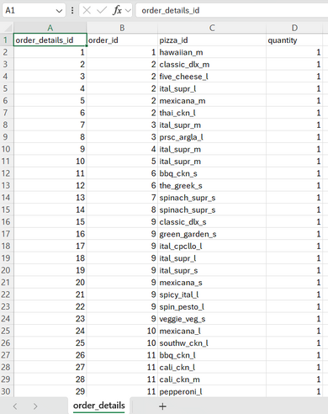
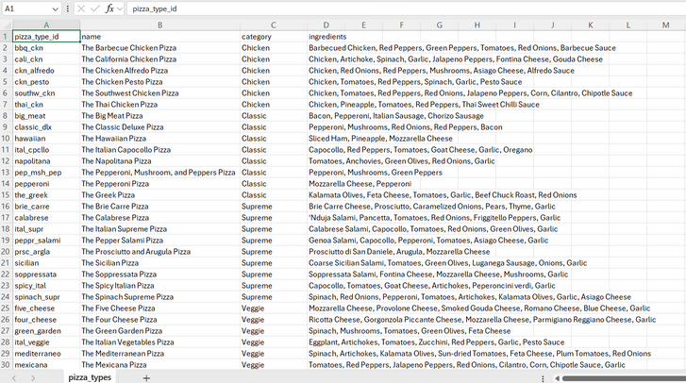
DATASET & SCHEMA
01
02
03
04
PIZZA_TYPES
PIZZAS
ORDERS
ORDER_DETAILS

Slide 4
Basic Analysis – overall orders, revenue, top pizzas.
Intermediate Analysis – category-level & time-based insights.
Advanced Analysis – revenue contributions & cumulative sales.
ANALYSIS ROADMAP

Slide 5
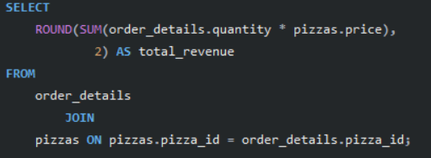
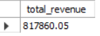
CALCULATE THE TOTAL REVENUE GENERATED FROM PIZZA SALES.

Slide 6
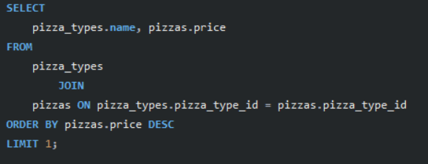
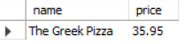
IDENTIFY THE HIGHEST-PRICED PIZZA.

Slide 7
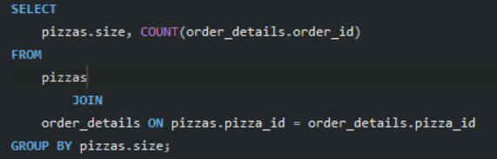
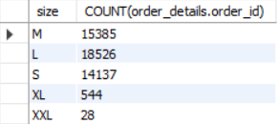
IDENTIFY THE MOST COMMON PIZZA SIZE ORDERED.

Slide 8
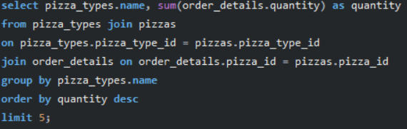
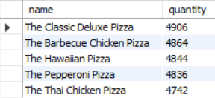
LIST THE TOP 5 MOST ORDERED PIZZA TYPES ALONG WITH THEIR QUANTITIES.

Slide 9
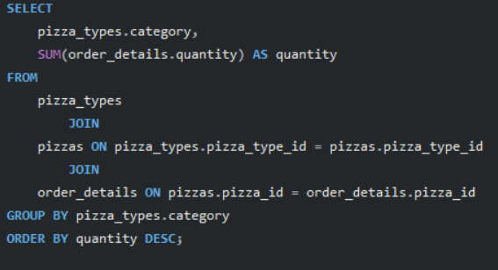
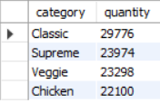
JOIN THE NECESSARY TABLES TO FIND THE TOTAL QUANTITY OF EACH PIZZA CATEGORY ORDERED.

Slide 10
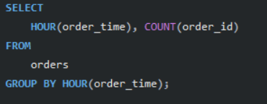
DETERMINE THE DISTRIBUTION OF ORDERS BY HOUR OF THE DAY.

Slide 11
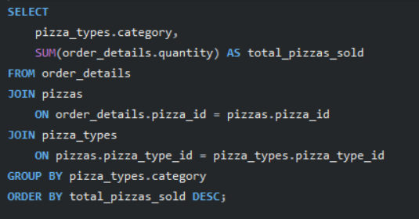
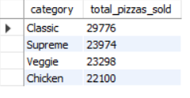
JOIN RELEVANT TABLES TO FIND THE CATEGORY-WISE DISTRIBUTION OF PIZZAS.

Slide 12
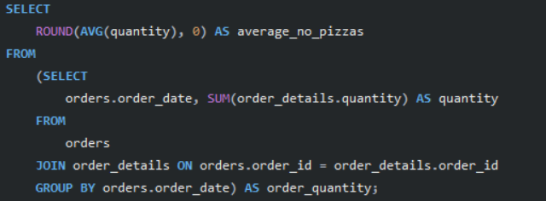
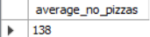
GROUP THE ORDERS BY DATE AND CALCULATE THE AVERAGE NUMBER OF PIZZAS ORDERED PER DAY.

Slide 13
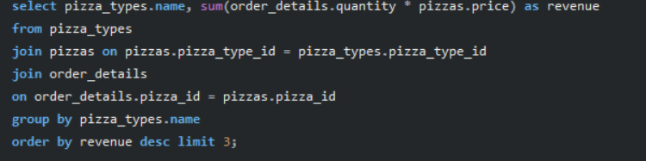
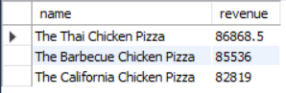
.
DETERMINE THE TOP 3 MOST ORDERED PIZZA TYPES BASED ON REVENUE.

Slide 14
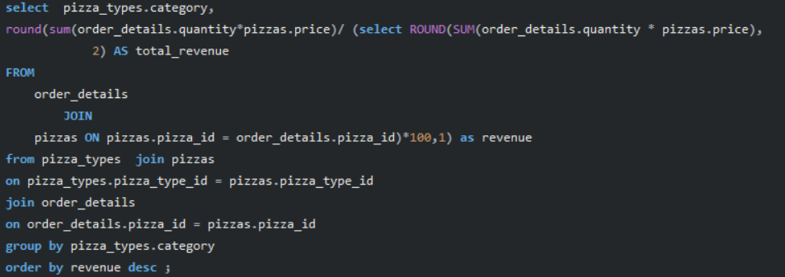
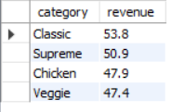
CALCULATE THE PERCENTAGE CONTRIBUTION OF EACH PIZZA TYPE TO TOTAL REVENUE.

Slide 15
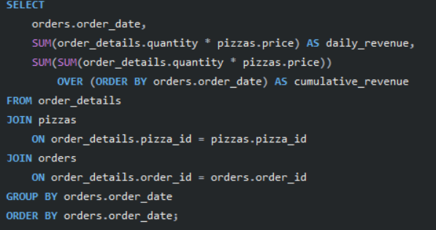
ANALYZE THE CUMULATIVE REVENUE GENERATED OVER TIME.

Slide 16
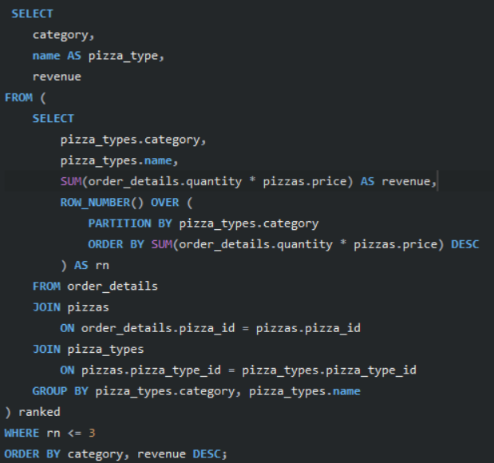
DETERMINE THE TOP 3 MOST ORDERED PIZZA TYPES BASED ON REVENUE FOR EACH PIZZA CATEGORY.

